Slide 1
Java-FLP project – CapStore (E-commerce - application) Team-7

Slide 2
Return Goods
Syam Kumar Puppala, Employee ID – 152995, JEE Full Stack June 13th Batch, MIPl.

Slide 3
Module-31: Return Goods
Customer can return sold products.it will be updated in the inventory. In case of third party merchant it will returned directly through third party interface.
Merchant can validate the product

Slide 4
Technologies Used:
Java 10
STS Version: 3.9.4.RELEASE
MySQL 5.5 Command Line Client
HTML 5
CSS 3
BootStrap
JavaScript
JSP
Spring Boot (2.0.4)
Spring Rest

Slide 5
Return Goods
Table Name- Return orders
Column Name | Data Types | Key Constraint | Description
1.Return Id | Integer | Primary Key(Auto Generated) | -
2.Order Id | Integer | Foreign Key From Orders tables | -
3.Custumer Id | Integer | Foreign Key From Customer table | -
4. Product Id | Integer | Foreign Key From Inventory table | -
5.Description | Varchar | Required | Reason for returning the goods
6.Return Mode | String |  | Mode of transaction
7.Return Date | System Date | Auto Generated | Date on which goods are returned
8.Status | String |  | Tracking of returned product
9.Validate | Boolean |  | Verification of product from merchant
Notes:
Usar para separador de capitulos . Seria bom ter esta versao em vermelho e verde tb..

Slide 6
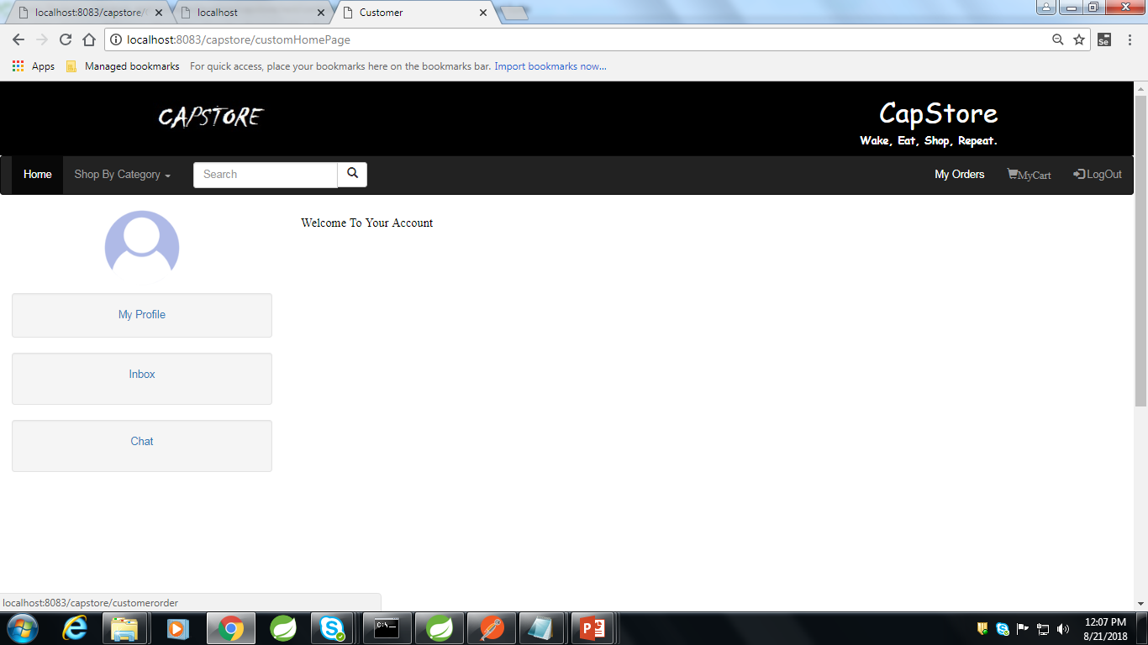
Customer Home Page

Slide 7
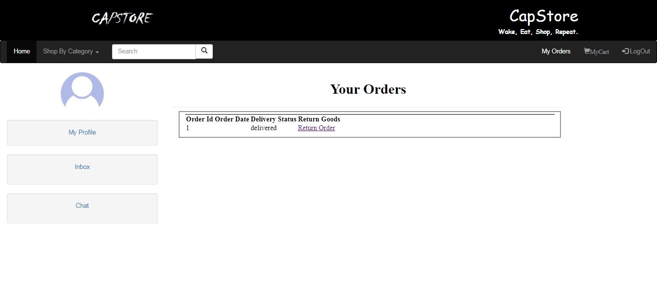
Customer Home Page-My Orders

Slide 8
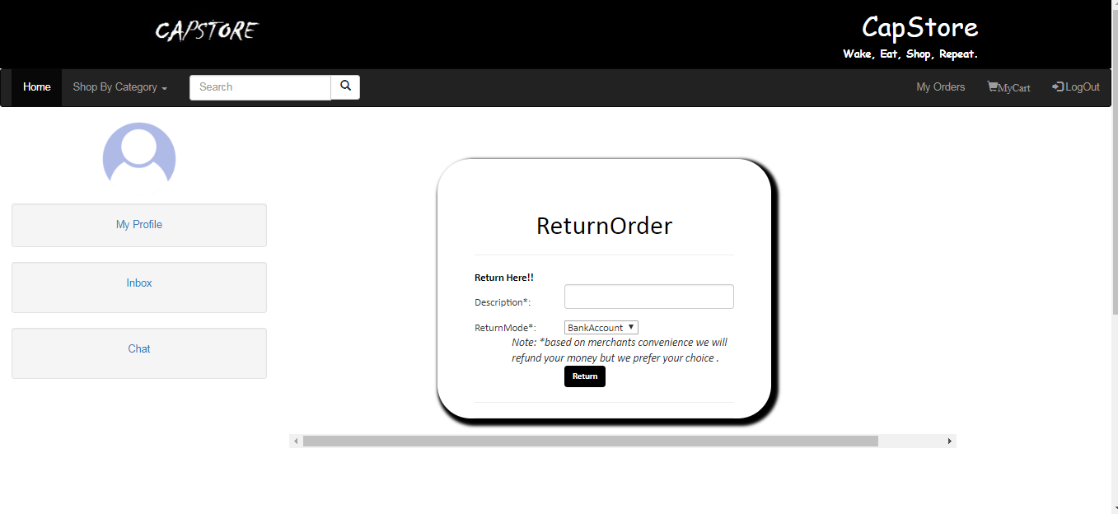
Customer Home Page-My Orders-Return Order

Slide 9
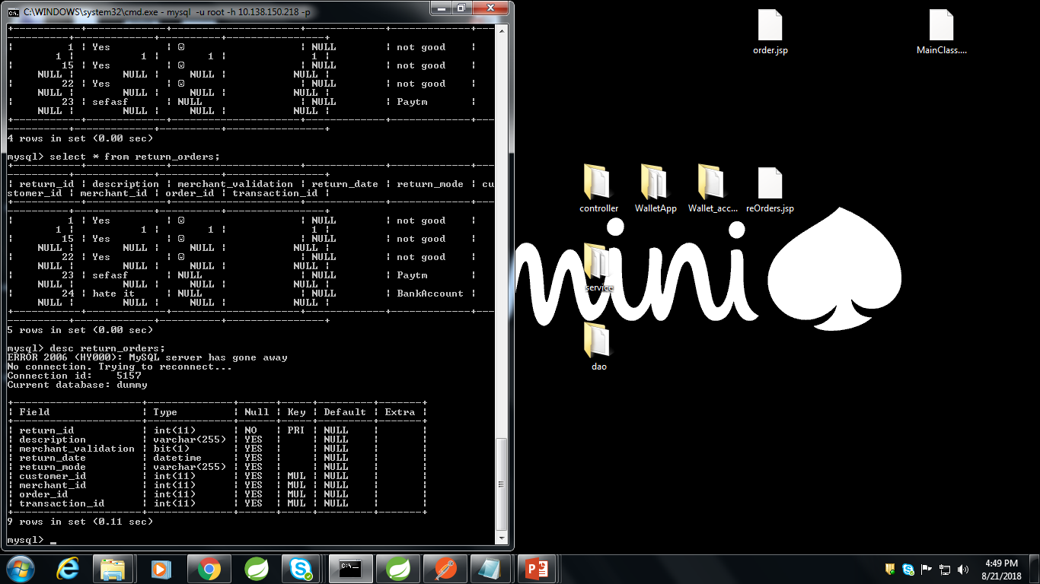
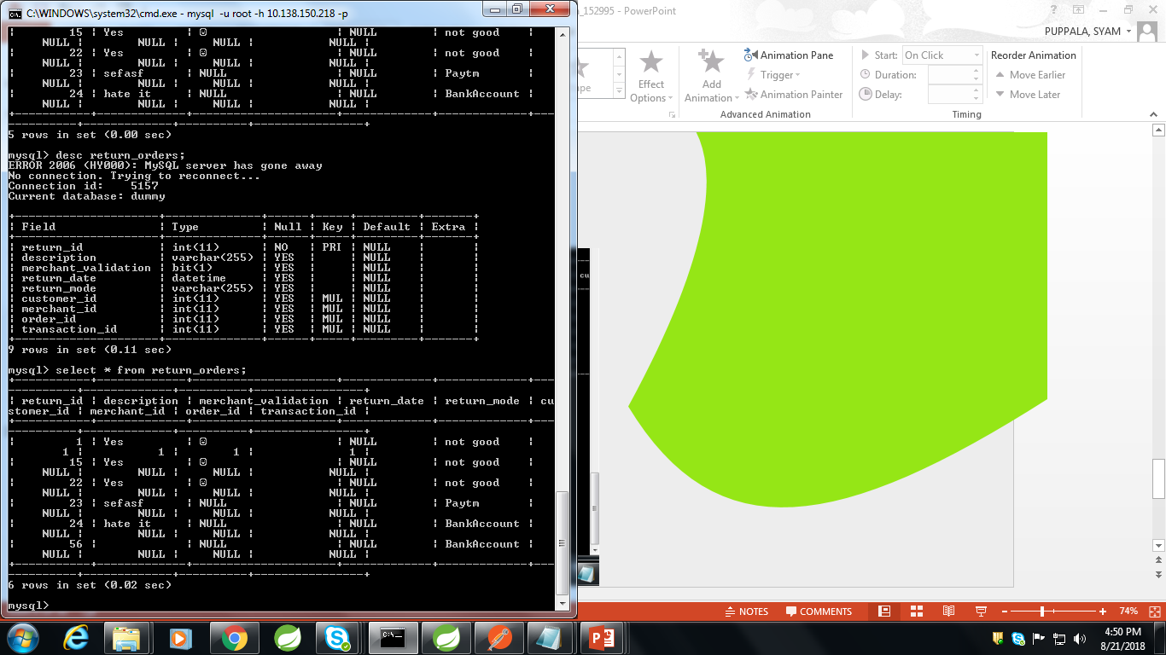
Return Order Table Values Remote Database
Return Order Table Structure In Remote Database

Slide 10
Thank You
Notes:
Usar para separador de capitulos . Seria bom ter esta versao em vermelho e verde tb..

